Slide 1
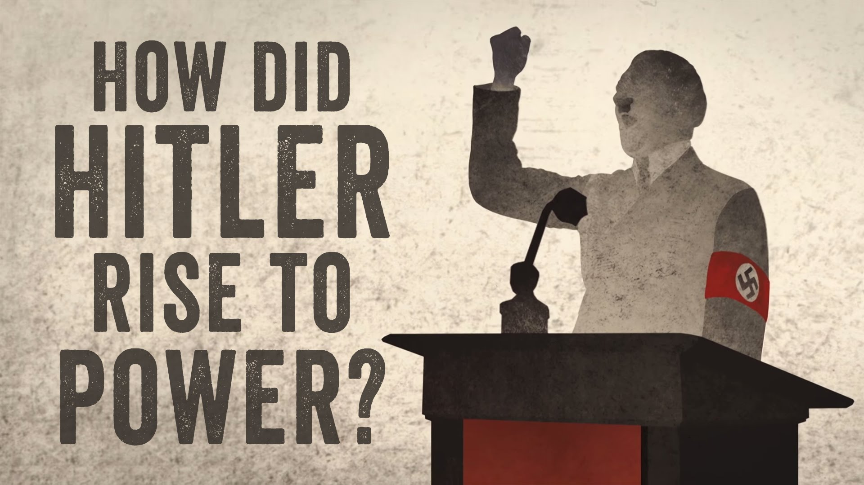
Hitler to power 1930 - 1933
https://www.youtube.com/watch?v=jFICRFKtAc4

Slide 2
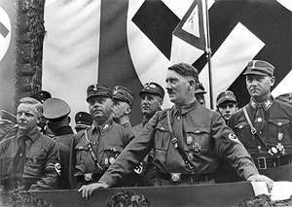
Background
The Nazis had 30,000 members in 1929 (pre Wall St. Crash)
After the Wall St. Crash (October 9th 1929) and moving forward into the following period the Nazi numbers swelled to over 440,000
Into the great depression the Nazis gained supporters rapidly

Slide 3
Support
Many of the Nazi supporters were used similarly to the SA (storm troopers formed 1921) - essentially as a group of thugs to break up opponent meetings and beat up Communists
This was helpful to the Nazis because it gave the public impression of lawlessness breaking out under Weimar's weak control. Voters began to look elsewhere (NAZIS) for the strong leadership the wanted
Hitler also promised to rid Germany of the treaty of Versailles - this gained the support of many
He also said he would solve unemployment - a problem which at the time was rapidly encroaching on the Ger. Public welfare
The Nazi uniforms and well organized political rallies gave a feeling of order to the distressed German public - promoting the Nazis popularity
It also reminded the public of the ‘good old days’ with the ex Kaiser when military prowess had more value (-the Kaiser abdicated in 1918)

Slide 4
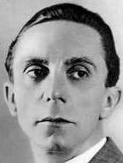
Propaganda
Propaganda was a important factor in the Hitler becoming chancellor in 1933. Goebbels was Hitler's propaganda advisor throughout his campaign and became official propaganda minister from 1933
He went on to influence many of Hitler's most successful political maneuvers throughout his campaign...

Slide 5
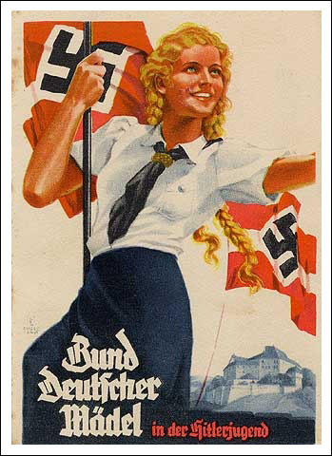
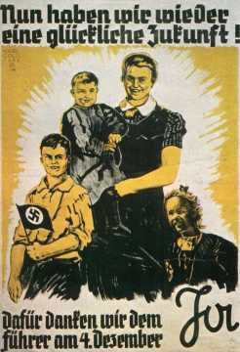
Propaganda
Goebbels propoganda emphasized family values and German traditions gaining Hitler many votes with Women

Slide 6
Propaganda
Again the militaristic processions and general decisive powerful aura; typical of the old Kaiser led government, gained the Nazis support and attracted voters away from the seemingly ailing Weimar government
Hitler's anti - Semitic policy also proved very successful as along with the Communists/foreigners and ‘November Criminals’ Hitler provided the public with someone to blame whilst making the Nazis more attractive option
Hitler was also a very charismatic public speaker (e.g. At the parties Nuremberg rallies) gaining him many votes
Goebbels also made sure radios were plentiful and cheap so as to get one in to every home to broadcast Hitler's message -though this came more after Hitler became chancellor
Continuing the use of technology, as well as radio’s, Goebbels also flew Hitler all over Germany to get him ‘seen’ as well as attract voters with Hitler's embracement of new Technology's

Slide 7
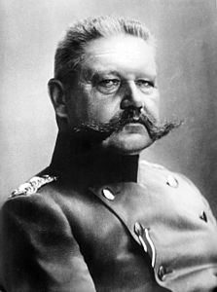
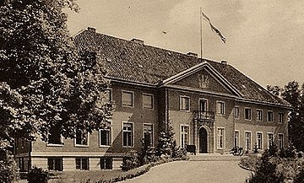
The rich (‘Junkers’) and middle class
During the great depression the upper classes and wealthy business owners ‘Junkers’, found themselves in an awkward position
They feared the growth in Communism in the desperate times (as they did not want their businesses and wealth to become state owned), they saw the Weimar government crumbling so voted Nazi (the wealthy also favored the Nazis more ‘Kaiser’ style characteristics)

Slide 8
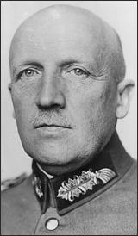
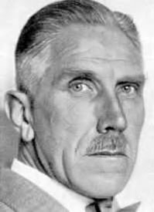
Political Maneuvering Leading to Hitlers rise to Power (1930 - 33)
The complex political maneuvering that led to Hitler gaining power in January 1933 involved four main people
President Hindenburg (elected 1925)
Von Schleicher
Von Papen
Hindenburg von Schleicher von Papen

Slide 9
Von Papen and Von Schleicher
Von Papen - Rich nationalist Catholic friend of Hindenburg distrusted Hitler
Von Schleicher - Army leader, advisor and friend of Hindenburg. Supported Von Papen to start with. Distrusted Hitler
von Schleicher von Papen

Slide 10
Time Line of Events
1932
July Elections -
Nazi Success
230 seats
Biggest party
November Elections
Nazi Failure
196 seats
Still biggest Party
December 3rd 1932 - Von Papen loses support
Hindenburg reluctantly appoints von Schleicher
Hitler requests to be Chancellor denied by Hindenburg. Instead Hindenburg appoints von papen as chancellor in coalition with Nazis - for their voting power
Yet again Hitler
Denied chancellorship
Given to Von Papen
Von Schleicher loses support for Von Papen - wants to be chancellor himself
= Von Schleicher vs. Von Papen

Slide 11
Time Line of Events
1933 January
30th
Hindenburg wants
Von Papen back as
Chancellor - but warned by advisors that this may cause Nazi revolt/Civil war =
Von Papen persuades Hindenburg that best solution is to make Hitler Chancellor and try and contoll him from inside = Hitler becomes chancellor
28th
Von Schleicher has
Lost all support forced to
resign
4th
Von Schleicher weakening support
22nd
Von Papen
Again requests for
Hitler to become chancellor
Hindenburg Denies
Von Papen see’s this as opportunity - switches support to Hitler - agrees to work with him in exchange for vice Chancellorship

Slide 12
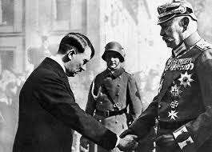
Hitler Becomes Chancellor
30th January 1933

Slide 13
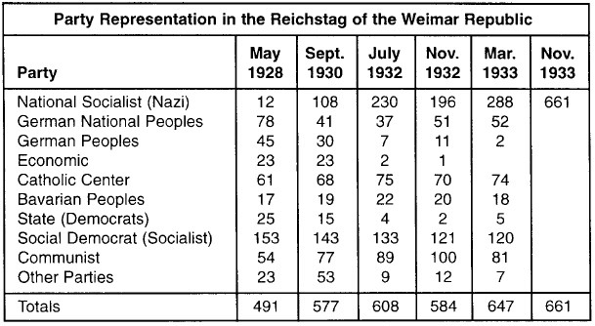
Election Results Through Period

Slide 14
Summary
The weaknesses of the weimar government
Political Maneuvering between Von Schleicher and Von Papen
Why did Hitler
Become Chancellor
In 1933?
The Depression
Nazi tactics (e.g. Goebells propaganda + SA)
Hitlers Leadership Skills

Slide 15
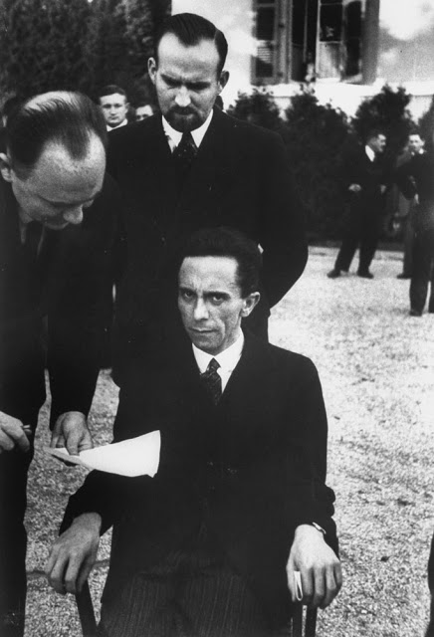
Source practice
Eyes of Hate: Joseph Goebbels Scowling at Photographer Alfred Eisenstaedt After Finding Out He's Jewish, 1933

